Slide 1
PHYS/SPCE 245
Rocket Science
Steve Curran, Laby 501
Stephen.Curran@vuw.ac.nz
Notes:
Hands on: example of product $z=xy$. Give 50 random values for x, 50 random values for y. Compute z and deduce stdev in z. Check it agrees with relative error formula.

Slide 2

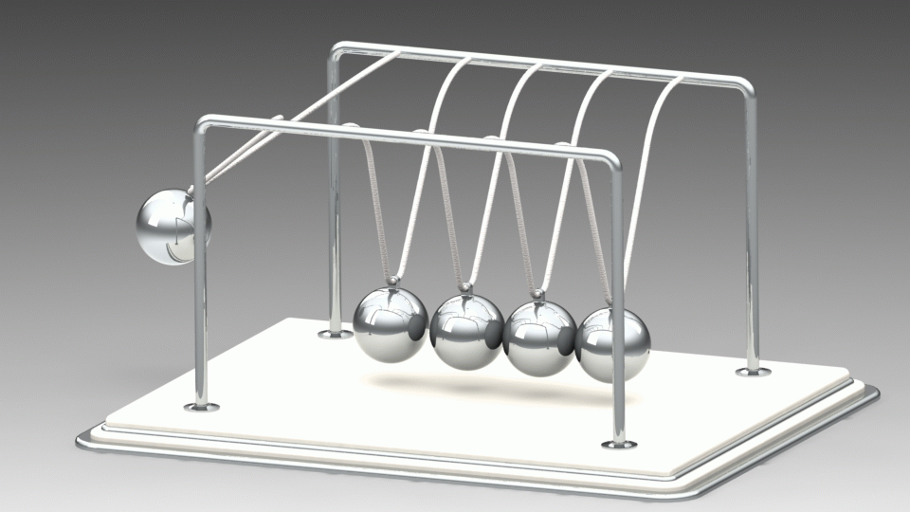

Rocket Propulsion
The rocket is propelled by the conservation of linear momentum (not by pushing against the ground, otherwise it wouldn’t work in space).
Again, much of the stuff on Fail Army is due to the misjudgement of linear momentum.

Slide 3
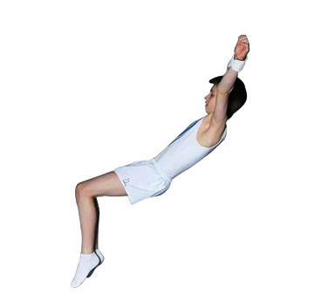
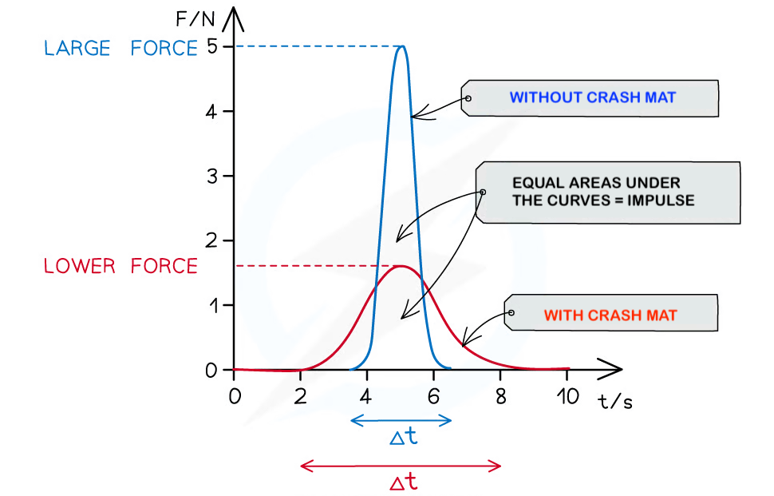
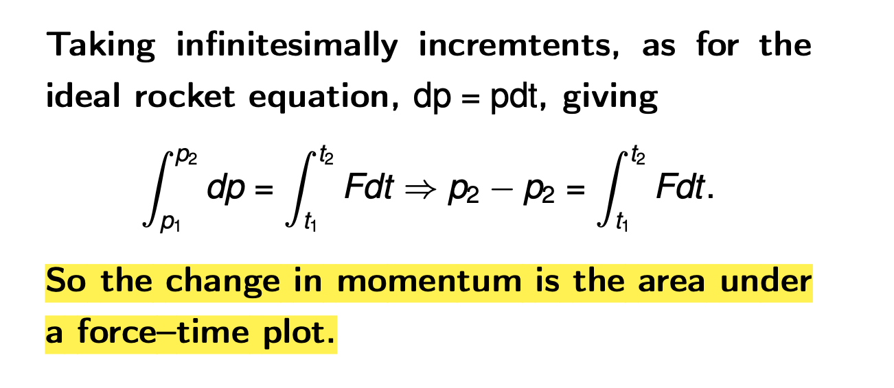

Impulse
So how is the launch force converted to the rocket’s momentum?
Impulse: FΔt = m Δv = Δp , i.e. F = Δp / Δt, the rate of change of momentum.
Impulse is the principle behind crash mats, air bags, crumple zones, padding in helmets, etc.
Although the momentum is the same, the force is spread over a longer Δt, thus reducing the force.

Slide 4
Ideal Rocket Equation
We start with the rocket in space, well away from gravitational force and air resistance.
The rocket increases its speed (accelerates) by burning fuel and so the mass is not constant. By ejecting gas of mass Δm , the rocket increases its speed by Δv, so the rocket’s momentum is
p_{rocket} = (m – Δm _{gas})(v + Δv )
The initial momentum is
p _{i} = mv
If the gas is expelled at speed u, this has a speed of v - u relative to the Earth, giving the total final momentum as
p _{f =} p_{rocket +} p_{gas =} (m – Δm_{gas} )(v + Δv ) + Δm_{gas} (v-u )
thrust
u
v
Notes:
https://pressbooks.online.ucf.edu/osuniversityphysics/chapter/9-7-rocket-propulsion/

Slide 5
By the conservation of momentum (no external force is acting), p_{f} = p_{i} , so
mv = (m – Δm_{gas} )(v + Δv ) + Δm_{gas} (v-u )
expanding this
mv = mv + m Δv – Δm_{gas}v - Δm_{gas}Δv + Δm_{gas}v - Δm_{gas}u
m Δv = Δm_{gas} Δv + Δm _{gas}u
Δm and Δv are small (dm and dv for those who have done calculus), so Δm Δv is tiny, giving
m Δv ≃ Δm _{gas} u
If a mass Δm _{gas} is ejected, the mass of the rocket + fuel decreases, i.e. Δm _{gas} = - Δm
Giving,
m Δv = - Δmu
Δv = - Δmu/m

Slide 6
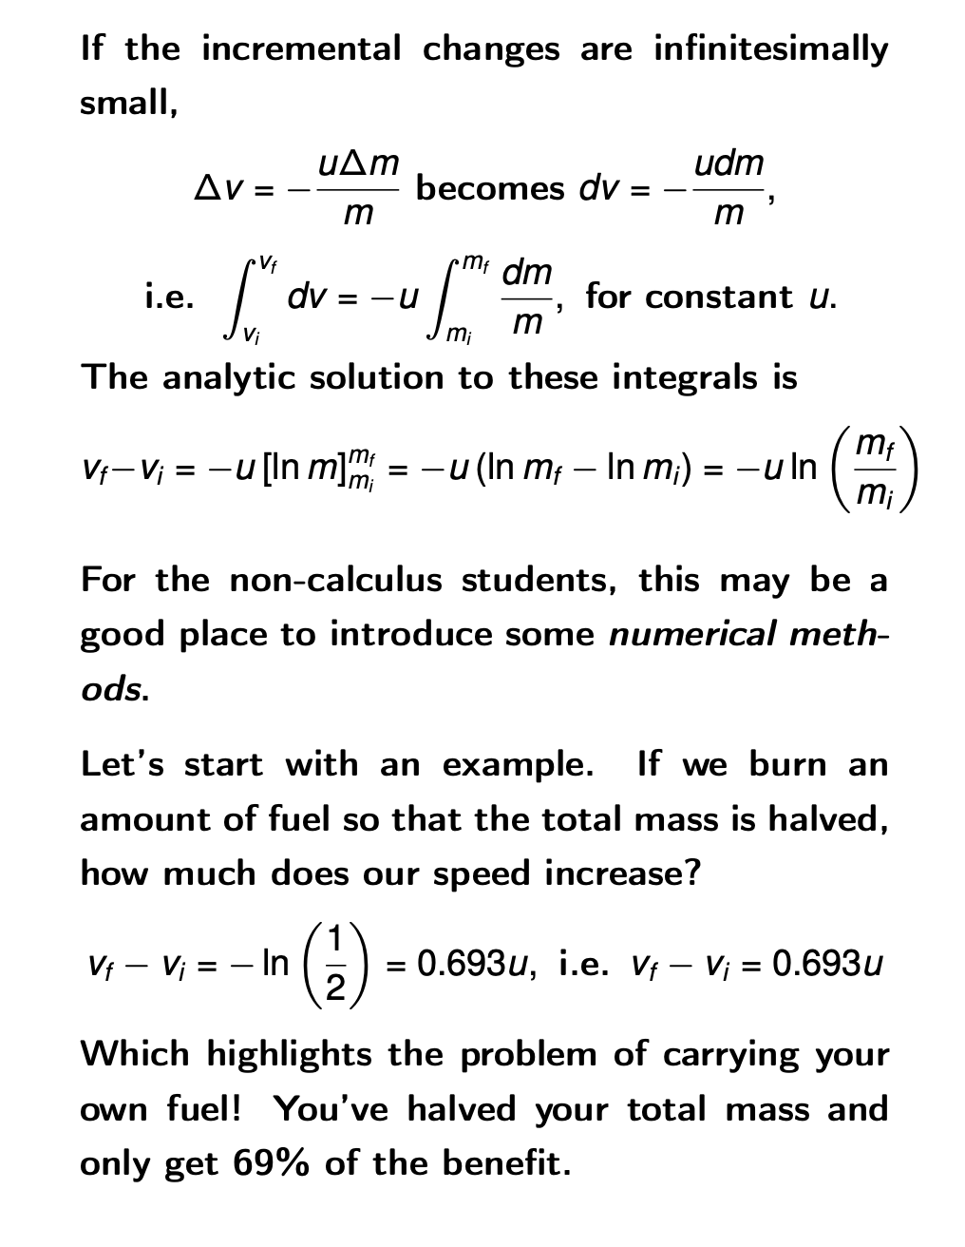
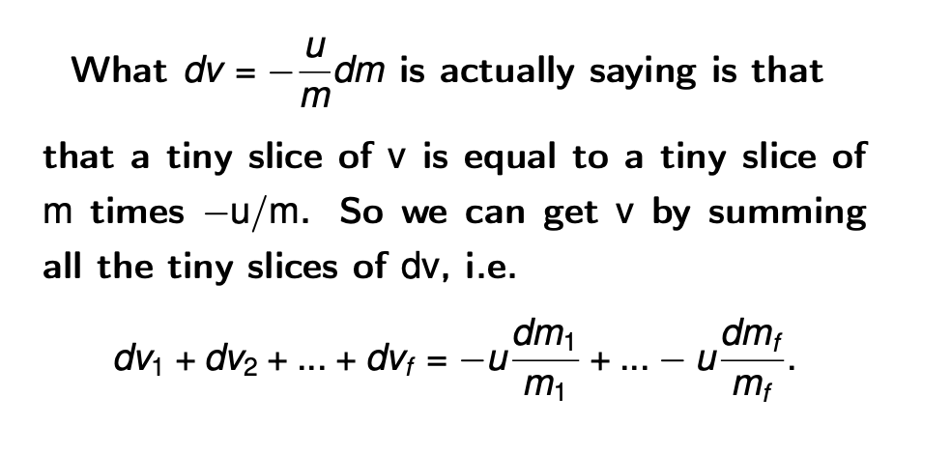
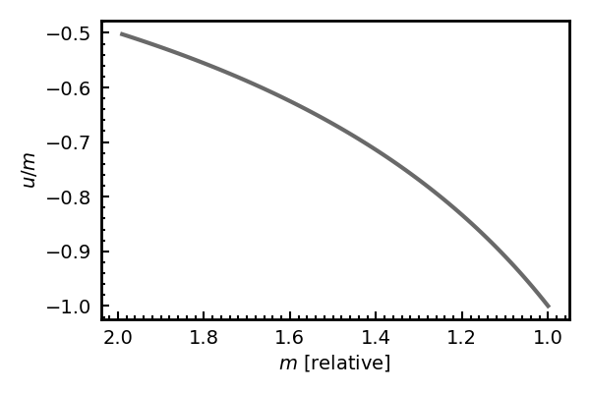

Slide 7
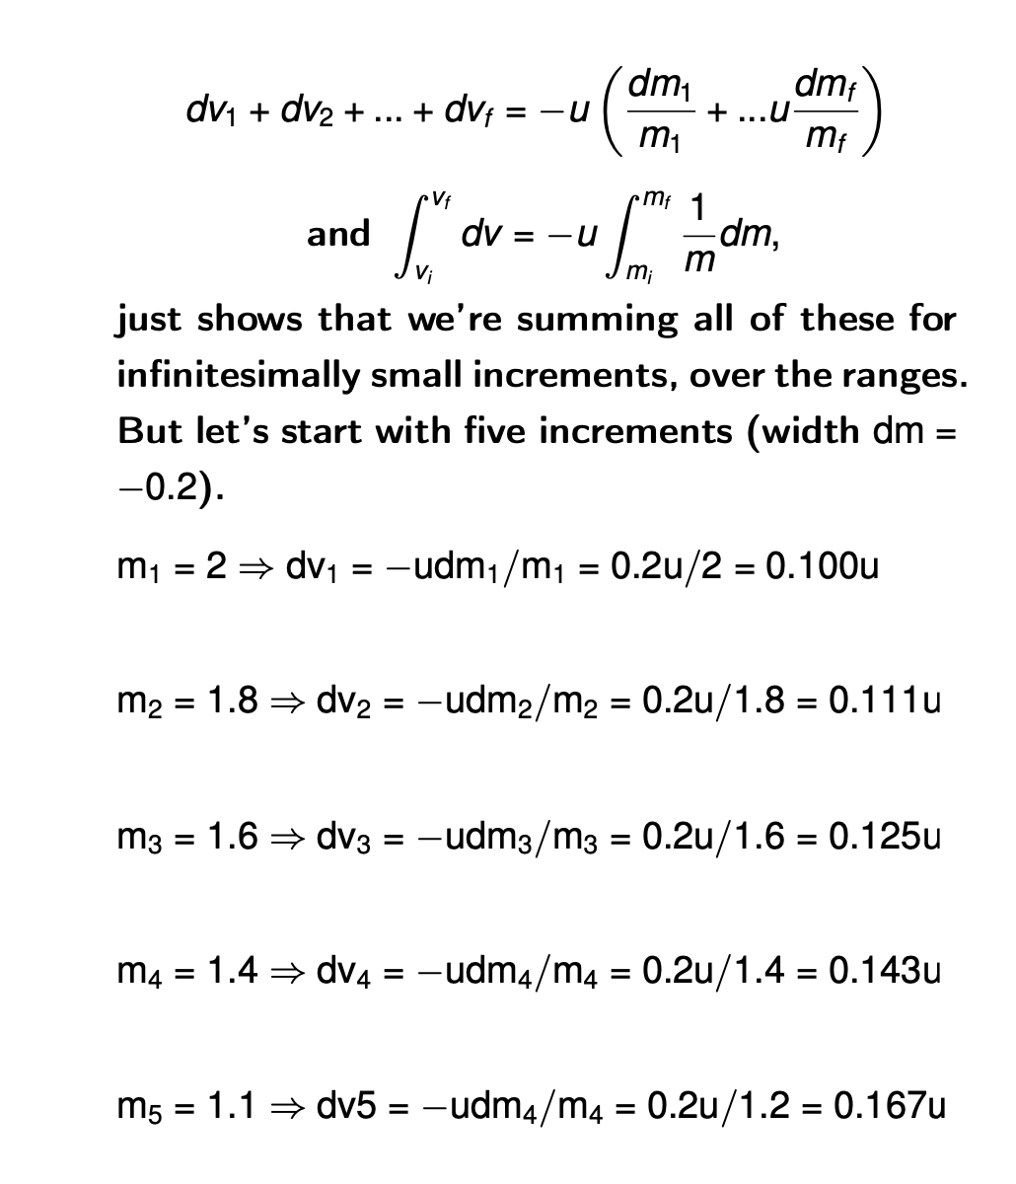
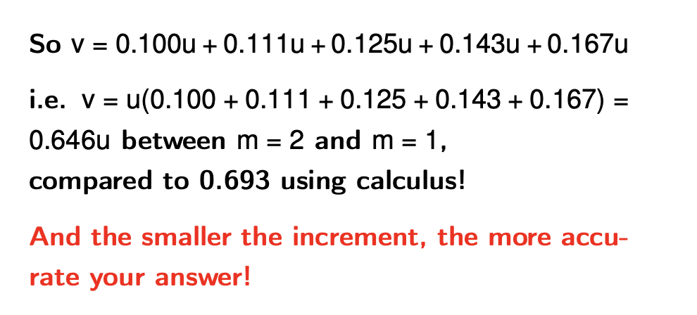
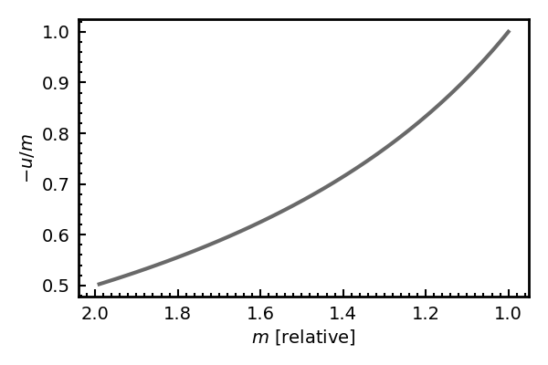
Turned upside down as I didn’t like how it looked
dm
Class exercise – do this for 10 increments

Slide 8

E.g. A rocket is in space free of gravity with an exhaust speed of u = 5 km s⁻¹. It if uses all of its fuel to accelerate, reducing the total mass by 90% (to a tenth of the initial value), by how much does its speed increase?
Δv = -u ln (m₂/m₁) = -5 ln (0.1/1) = 11.5 km s^{-1.}

Slide 9
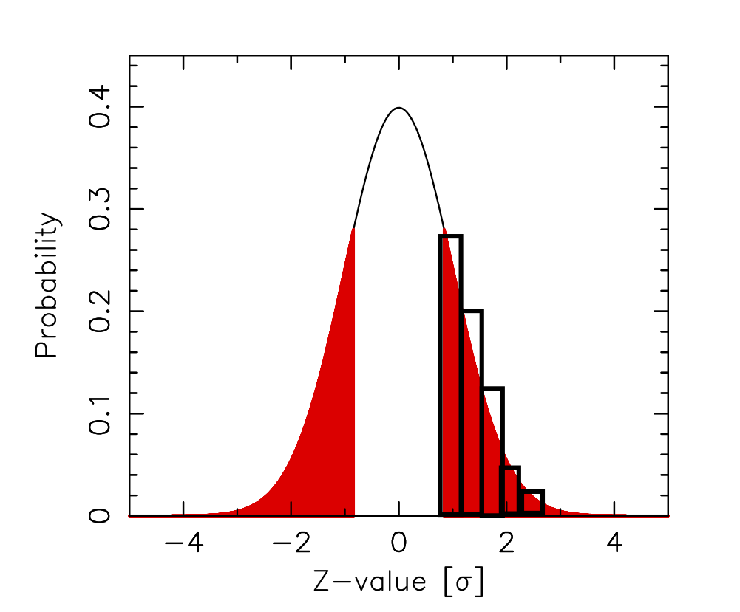
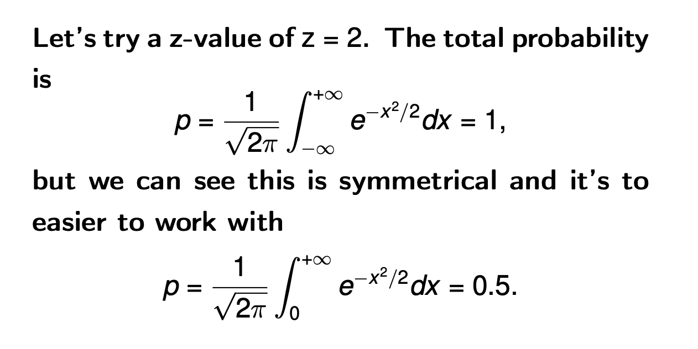
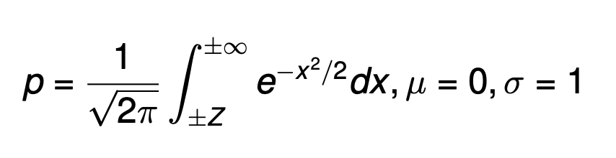
Another Integration Example
Those who have done calculus may now be saying “so what!” Yes, it is nice to be able to solve the integral analytically, but this is a course on experimental data which does not necessarily give a nice function which can be solved analytically.
Sometimes this can’t even be done with a nice function. E,g, the Normal distribution can’t be integrated analytically.
Notes:
Asked Sarah for light data, but in the meantime

Slide 10
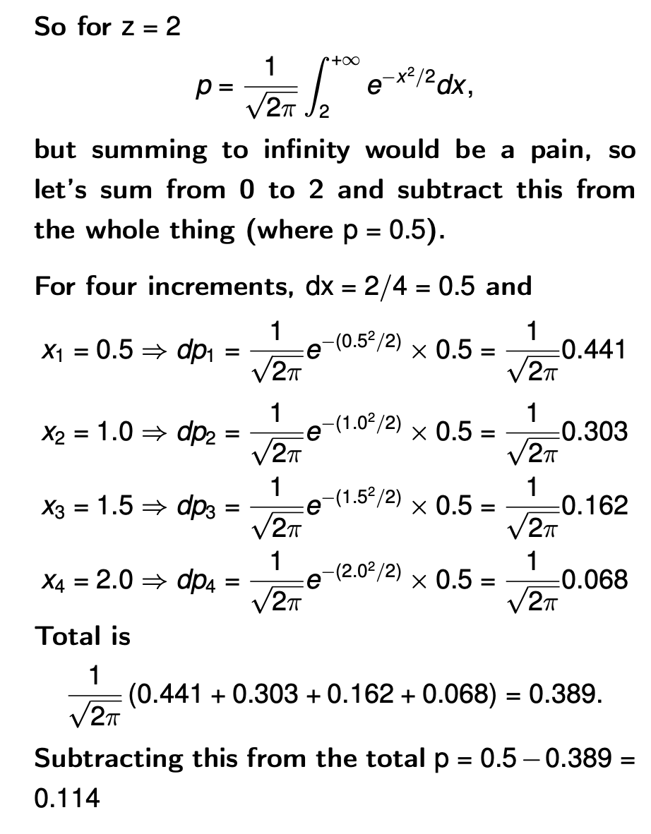
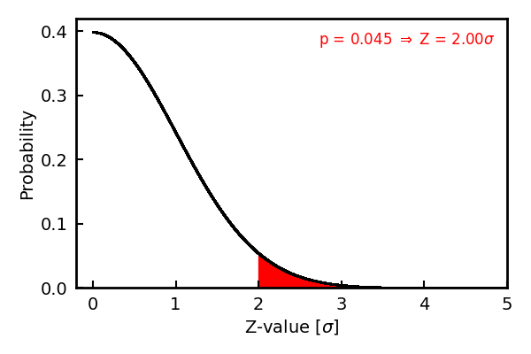
p = 0.11, which is about double that expected, but increments are very coarse (I used 10,000 to get p = 0.045)
Notes:
They’ve covered Raman spectrum – integrate under this

Slide 11
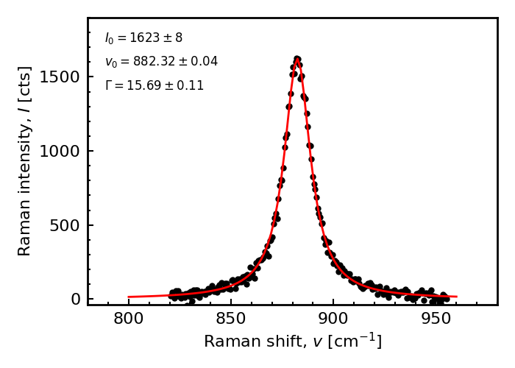
For some real data, let’s use Eric’s Raman spectrum from the non-linear fitting lecture. What is the overall intensity of the spectrum? The y-axis gives the specific intensity (per cm⁻¹), for total have to integrate over the spectrum.
I’m guessing that cts is counts like in the first lab. On the x-axis cm⁻¹ is wavenumber, which is a (to me, confusing) way of writing frequency. k = 882 cm⁻¹ = 882 x 10³ m^{-1.} λ = 1/k = 1.1 μm, which is in the near infra-red. The frequency (in proper units) is
ν = c/λ = ck = 3 x 10^{8 x} 882 x 10³ = 2.65 x 10¹⁴ Hz , but we’ll stick with the given units for this.

Slide 12
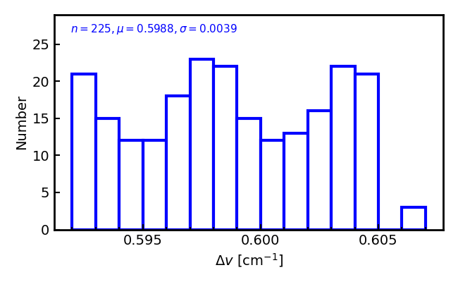
226 data points
v [cm^-1],I [cts]
820.58844,22.64906562
821.19336,48.06717582
821.79822,17.20800374
….
954.1261,21.69538279
954.7182,12.14243492
955.31024,0.778984764
And we can get the data intensity by summing Δx.y. For this real data, unlike the the previous sample there is no point doing this for than 226 times, as we would be merely interpolating between points to get data we don’t have.
First thing is to determine Δx. E.g. 821.19336 - 820.58844 = 0.605 and 955.31024 - 954.7182 = 0.592, which are not exactly the same, but may be near enough
v [cm^-1. v_prev dv
0 820.58844 NaN NaN
1 821.19336 820.58844 0.60492
821.79822 821.19336 0.60486
822.40515. 821.79822 0.60693
.. ... ... ... ...
224 954.71820 954.12610 0.59210
225 955.31024 954.71820 0.59204
v_prev is the previous value and dv the difference (Δx)

Slide 13
Using Δx = 0.5988, we just have to sum all the y-values and multiply by this, which gives
I_{int} = 36.99 x 10³ cts cm⁻¹.
If the channel width changes a lot, should sum each rectangle individually, giving
I_{int} = 37.03 x 10³ cts cm^{-1.}
So not much in it.
Being really fancy, although we can’t improve the resolution for area of first channel, instead of
A₁ = y₁(x₂ - x₁) we can use
A₁ = y₁ (x₂ - x₁) - ½ (x₂ - x₁) (y₂ - y₁)
= Δx (1.5y₂ - 0.5y₁) = Δx (y - ½ Δy )
e.g. (821.798 - 821.193)(1.5 x 7.208 - ½ 48.067 ) = -8.00
Doing whole spectrum gives I_{int} = 37.03 x 10³ cts cm⁻¹, which is probably overkill with no real gain. Might be worth it for coarser data though.
v [cm^-1] I [cts] v_prev dv
0 820.58844 22.649066 NaN NaN
1 821.19336 48.067176 820.58844 0.60492
2 821.79822 17.208004 821.19336 0.60486
3 822.40515 7.195470 821.79822 0.60693
4 823.00995 54.836356 822.40515 0.60480
y₁
y₂
x₁
x₂
Notes:
dy = y2 – y1 then. 1.5y2 – 0.5y. 1 = dy + 0.5y2 + 0.5y1 so

